Slide 1
Shell Bootcamp 2024 3 Reflections for Week #<>
Riya Gandhi
Date : 30-Aug-2024

Slide 2

About Me
‘Embrace the effort, let go of the outcome.’ This motto describes me the most. I intend to focus mostly on the work. I have been focusing on having a growth mindset rather than a fixed one and trying to step out of my comfort zone. I wish to keep learning things no matter how much time it would take to change myself. One thing I learnt and understood from the sessions is that it is okay to be wrong and be laughed upon, take it positively and just move on with the learnings.

Slide 3

My learnings from this week!

Slide 4
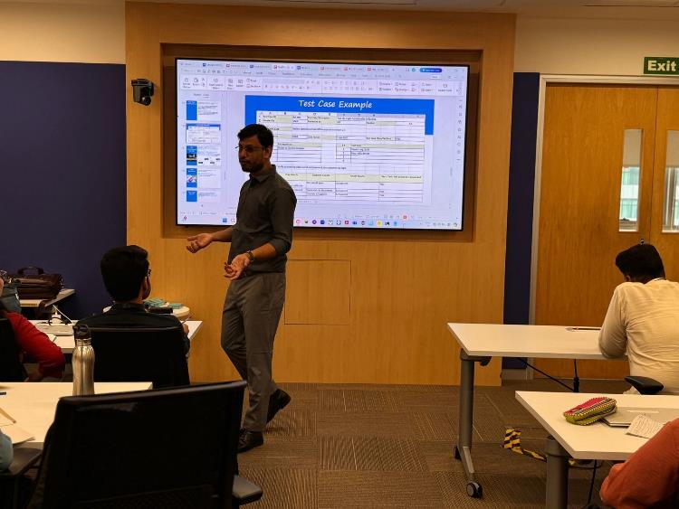
Learning 1 | My takeaways
Key Learning: Introduction to Agile methodology, focusing on roles (Product Owner, Scrum Master, Development Team, etc.), tools like Azure DevOps, and testing types.
Key Takeaway: Understanding how Agile and DevOps principles are fundamental for efficient software development and delivery.
Implementation in Energy Sector: These principles can optimize project management in energy projects, ensuring timely and high-quality software delivery, crucial for operational efficiency in a fast-paced environment like Shell.

Slide 5
Learning 2 | My takeaways
Key Learning: Focused on testing methodologies, including compliance testing, retesting, and different types of testing (functional, non-functional, white box, black box, etc.).
Key Takeaway: The importance of rigorous testing to ensure software reliability and compliance, particularly in high-stakes sectors like energy.
Implementation in Energy Sector: Effective testing can prevent costly errors and ensure regulatory compliance, which is vital for safety and efficiency in the energy sector.

Slide 6
Learning 3 | My takeaways
Understanding how different architectures support application scalability and performance, and how DevOps accelerates delivery.
Implementation in Energy Sector: These architectures can support Shell’s complex applications, while DevOps ensures they are developed and deployed efficiently.

Slide 7
Learning 4 | My takeaways
Understanding Bug Types:
Learned about various types of bugs and their characteristics.
Bug Life Cycle:
Studied the complete life cycle of a bug, from identification to resolution.
Practical Task:
Created test cases and bug reports.
Monitored and cross-questioned by the instructor to ensure thorough understanding.
DBMS Learning:
Gained knowledge about Database Management Systems (DBMS).
Participated in an assessment on DBMS, cloud, and DevOps.

Slide 8
Learning 5 | My takeaways
Case Study Analysis:
Analyzed the Orange HRM website.
Created user stories.
Test Case Development:
Developed 25 test cases.
Identified and documented bugs in a bug report.
Requirements Traceability Matrix (RTM):
Created an RTM to ensure all requirements were covered by test cases.
CI/CD Pipeline Implementation:
Set up a virtual machine (VM).
Created and implemented CI/CD pipelines.
Review and Presentation:
Reviewed the work.
Presented findings and implementations.

Slide 9

Relevance of learnings for my organization

Slide 10
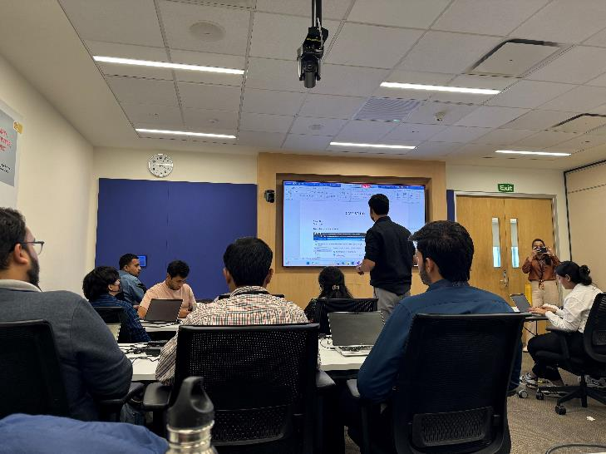
Learning 1 | Relevance for Shell
How Shell Implements: Shell likely utilizes Agile and DevOps to streamline software delivery, making it adaptable to the ever-changing demands of the energy sector.
Benefits to Shell: Enhances project efficiency, reduces time-to-market, and allows for better collaboration among teams, ultimately driving innovation.

Slide 11
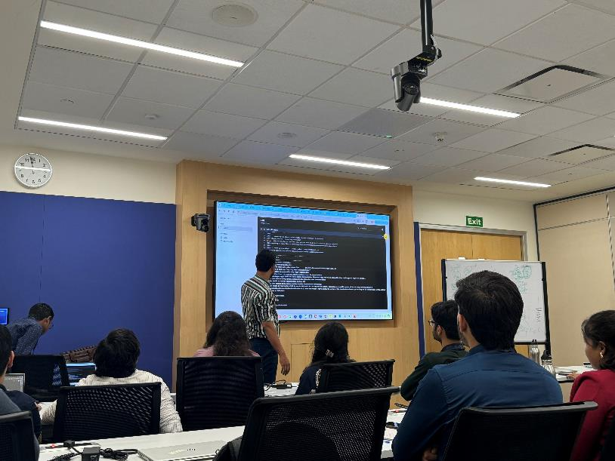
Learning 2 | Relevance for Shell
Shell likely emphasizes thorough testing to maintain the integrity and security of their software systems.
Benefits to Shell: Helps in avoiding operational disruptions, ensuring the software meets both business and regulatory standards.

Slide 12
Learning 3 | Relevance for Shell
Shell’s IT infrastructure likely uses multi-tier architectures to handle large-scale applications, and DevOps practices for continuous integration and delivery.
Benefits to Shell: Enhances system scalability and performance, allowing Shell to manage extensive and complex operations seamlessly.

Slide 13
Learning 4 | Relevance for Shell
Bug Management: Understanding bug types and their life cycle is crucial for maintaining and improving Shell’s digital systems. Efficient bug tracking and resolution ensure system reliability and performance.
Test Case Development: Creating detailed test cases and bug reports enhances the quality assurance process, leading to more robust and error-free software solutions.
DBMS Knowledge: Proficiency in DBMS is essential for managing Shell’s vast data repositories, ensuring data integrity, and optimizing database performance.
Cloud and DevOps Skills: Knowledge in cloud computing and DevOps practices supports Shell’s digital transformation by enabling scalable, efficient, and automated IT operations.

Slide 14
Learning 5 | Relevance for Shell
Day 5 was packed with learning and practical tasks.
We analyzed the Orange HRM website, created user stories, developed 25 test cases, and documented bugs.
We also created an RTM and set up a VM to implement CI/CD pipelines, gaining hands-on experience. The day included reviewing our work, presenting findings, and creating documents with technical and functional requirements in mind.
We revised previous topics, learned about teamwork, and how to handle such events.
Overall, it was an enriching experience combining theory and practice.
These activities taught us how technical work culture works in shell. How are we expected to work and perform under pressure and deliver the end results on time.
Riya2919/Shell_Case_Study- (github.com)

Slide 15

Challenges in implementing learning

Slide 16
Challenge faced while implementing Learning 1
Challenges: Initially, understanding the Agile roles and their specific responsibilities in a large organization like Shell was challenging.
Plan to Overcome: Engage in more practical scenarios and seek mentorship from senior team members to solidify understanding.

Slide 17
Challenge faced while implementing Learning 2
Challenges: Difficulty in writing comprehensive test cases, particularly for complex systems.
Plan to Overcome: Practice writing test cases using different scenarios and reviewing industry standards to improve accuracy and coverage.

Slide 18
Challenge faced while implementing Learning 3
Challenges: Grasping the differences between various architectures and their specific use cases.
Plan to Overcome: Engage in hands-on projects that involve different architectures and seek guidance from experienced colleagues.

Slide 19
Challenge faced while implementing Learning 4
Challenges faced are as follows:
1) Test Case Development: Creating detailed test cases and bug reports under pressure enhances the quality assurance process, leading to robust software solutions.
2) In activity, initially it was not created properly, but the team had implemented proper changes at the end.
3) DBMS Knowledge: Quickly grasping complex DBMS concepts is crucial for managing Shell’s data repositories, ensuring data integrity, and optimizing performance.

Slide 20
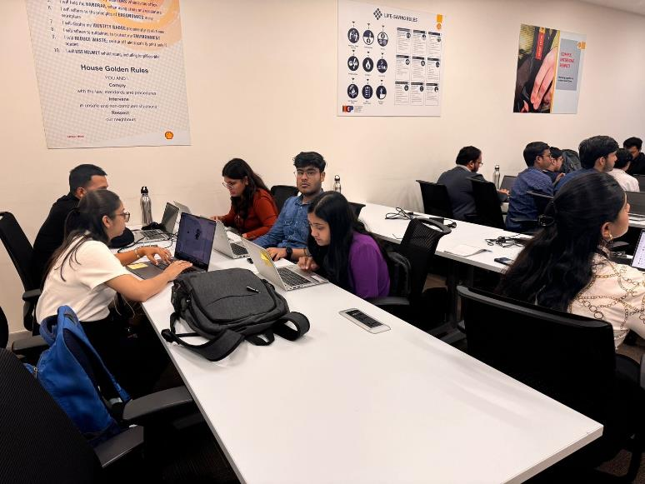
Challenge faced while implementing Learning 5
The initial challenges faced included :-
Creation of vm’s, as they were not getting deployed.
The implementation of CI/CD pipeline was not implemented in a one go, but the error was resolved later on.
Teamwork and how the technical aspects are documented.

Slide 21

Action Plan

Slide 22
My Action Plan for this Week
Actions
Timeline
Status
Introduction to Agile principles, Scrum framework, and Agile ceremonies. Covered key responsibilities, requirement gathering techniques, and stakeholder management. Explored different types of testing (unit, integration, system, acceptance), testing tools, and best practices. Discussed various Software Development Life Cycle models (Waterfall, V-Model, Agile, Spiral). Introduction to DevOps culture, CI/CD pipelines, tools like Jenkins, Docker, and Kubernetes.
This week covered all the foundational technical knowledge needed.
Upcoming sessions will have lot of fun activities and new learning opportunities.
I have already started implementing things taught in soft skills sessions and now I am focusing more on the technical training topics.

Slide 23

Learning is also Fun!

Slide 24
Learning is also Fun!
There were so many fun activities, but I personally enjoyed pen-and-string activity demonstrating teamwork.
I also remember the role plays we had as a board meeting discussion which went very well.
On Day 5 we were asked to create BRD and SRS documents, we also did the activity which included creating test cases and bug report.
The last day had a case study, which included all of our learnings from the whole week, and it was a really great experience sipping in all the knowledge the instructor gave.
I tried paying attention to all the small details and cover as much as I could.

Slide 25

Summary
Quick summary – The whole week had technical training, which covered the topics like software testing, DBMS, DevOps, Cloud computing and agile methodology.
Next week I would be joining my team.

Slide 26
Thank You

